Slide 1


Slide 2
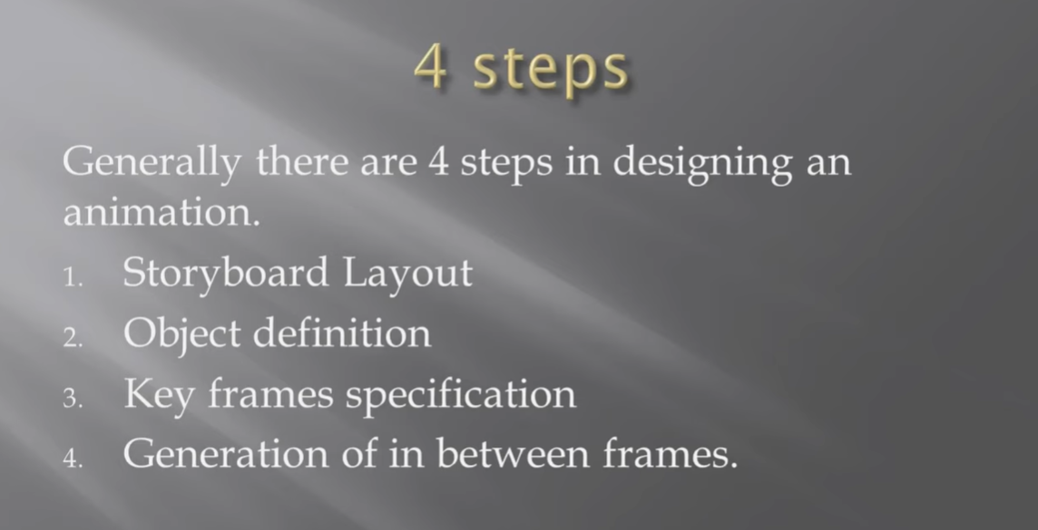

Slide 3
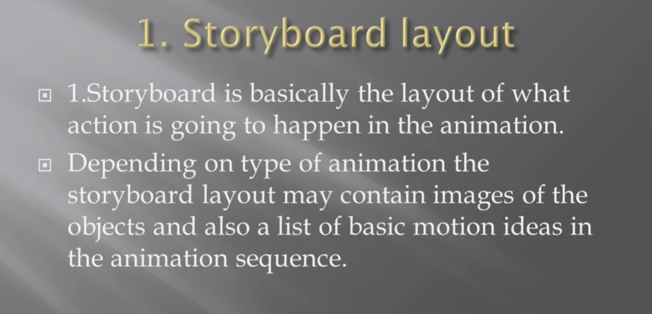

Slide 4
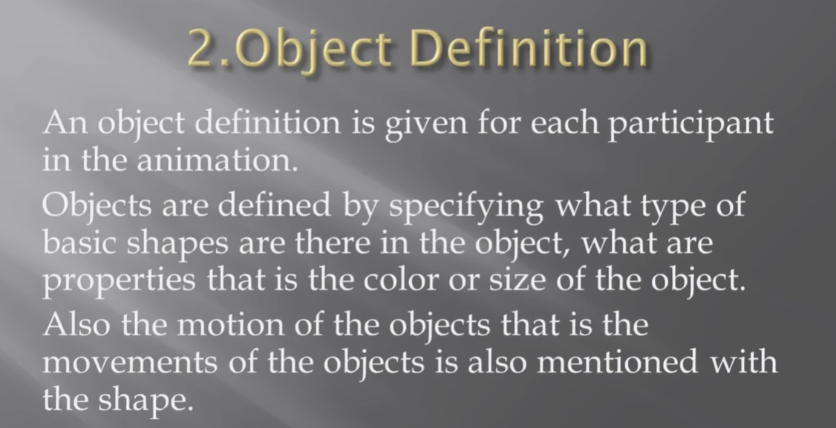

Slide 5
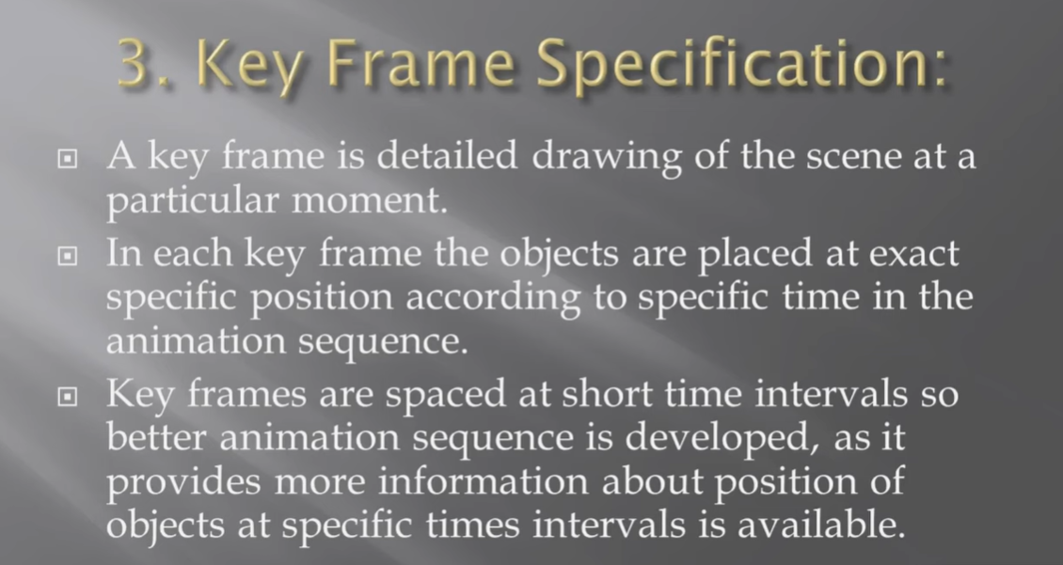

Slide 6
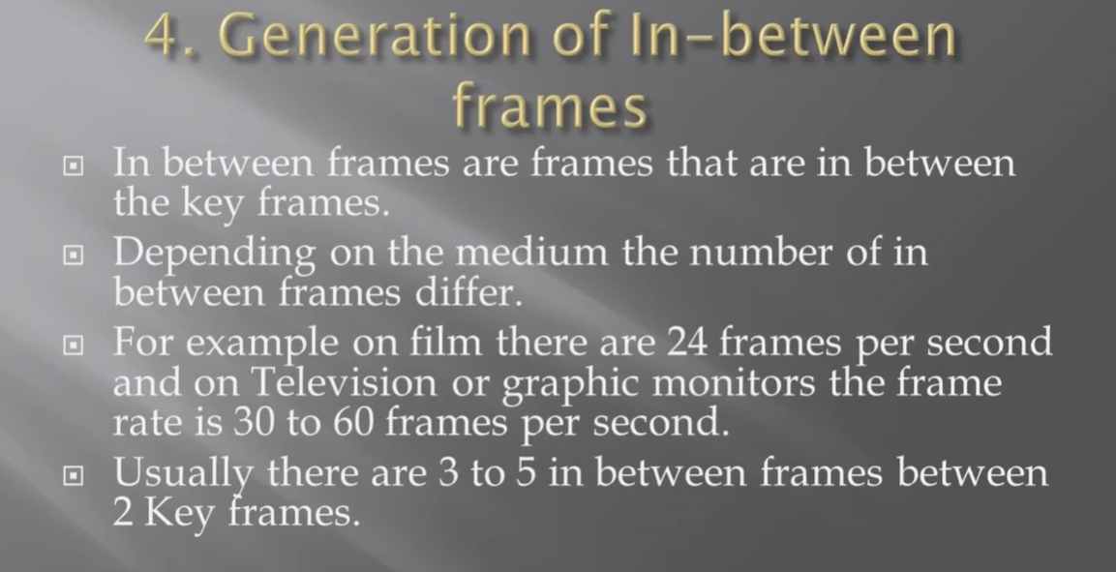

Slide 7
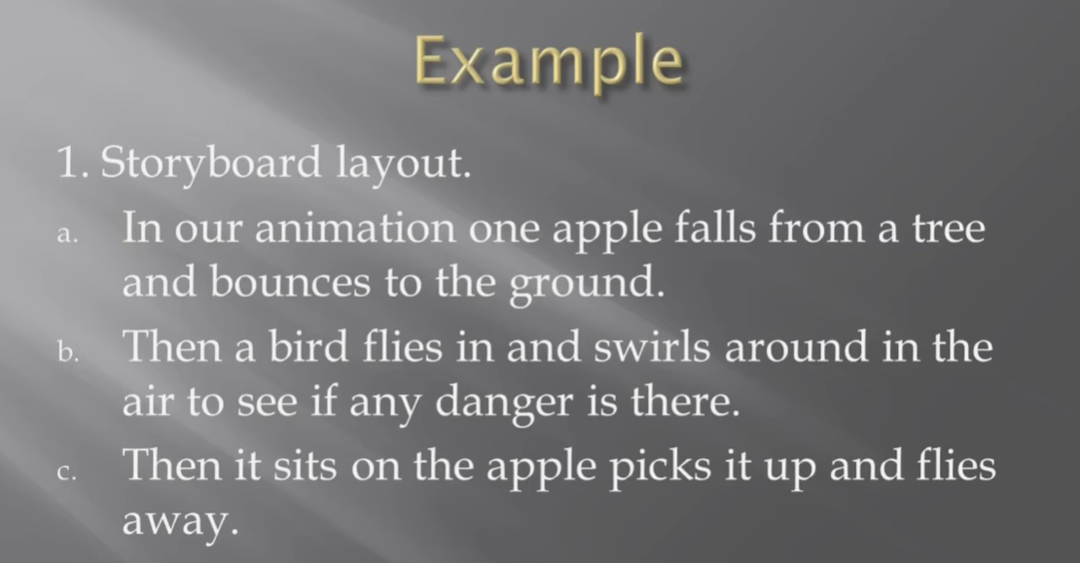

Slide 8
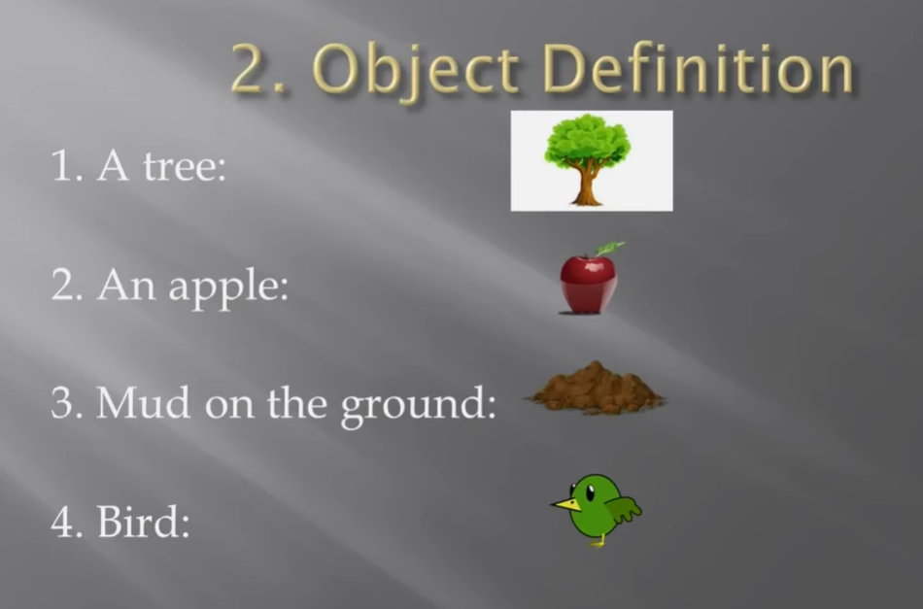

Slide 9
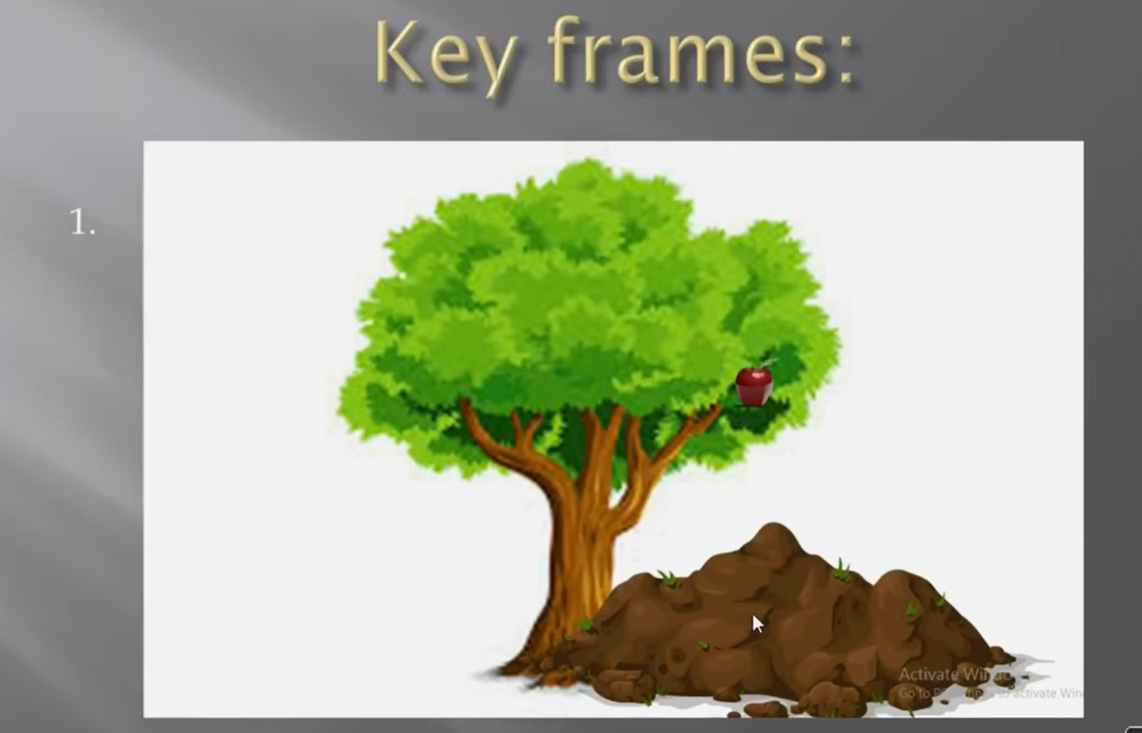

Slide 10
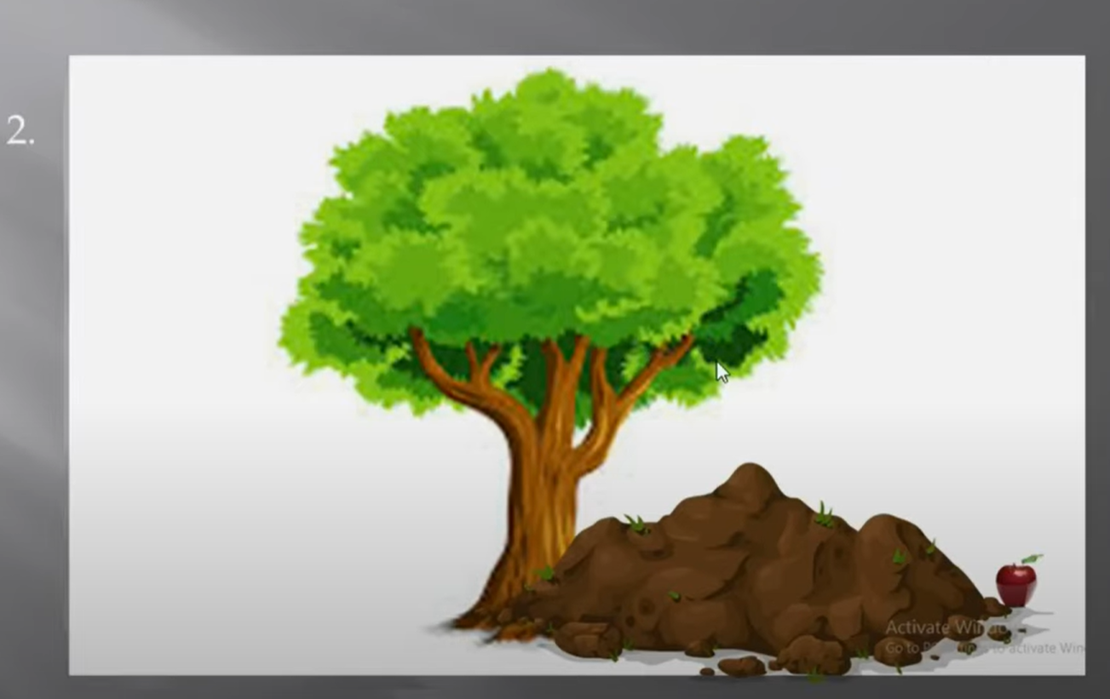

Slide 11
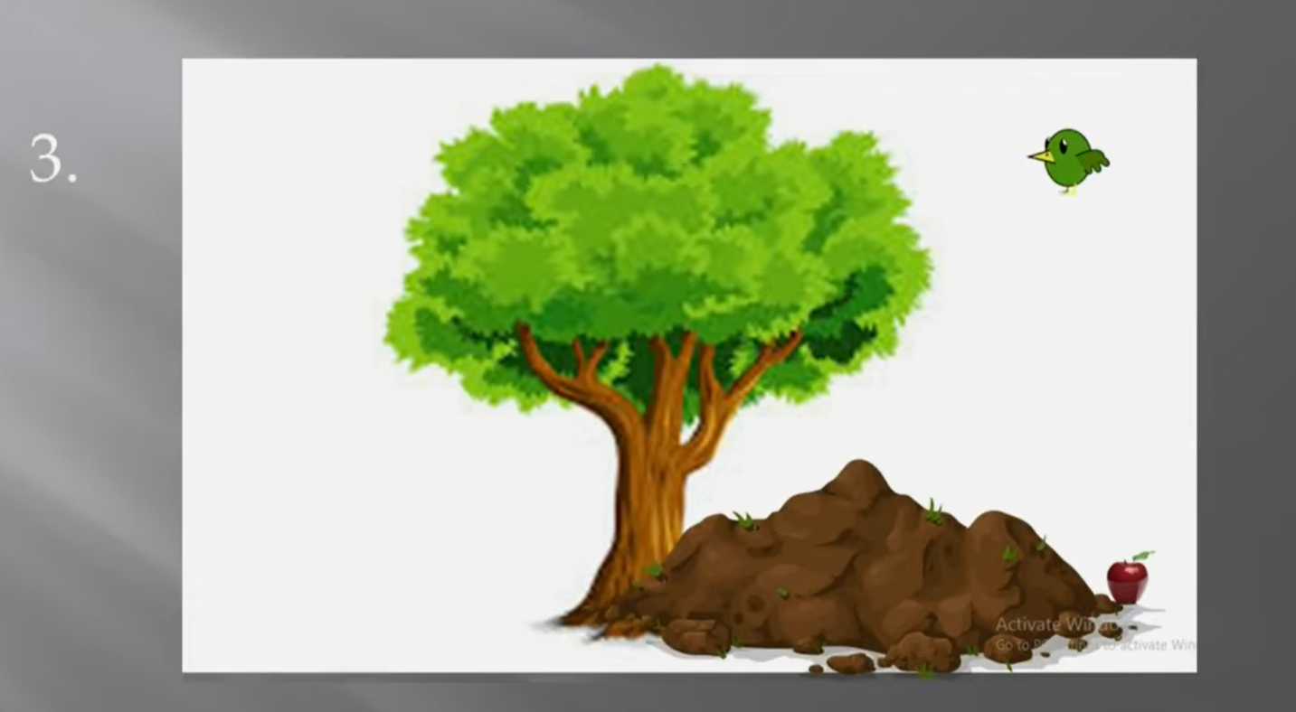

Slide 12
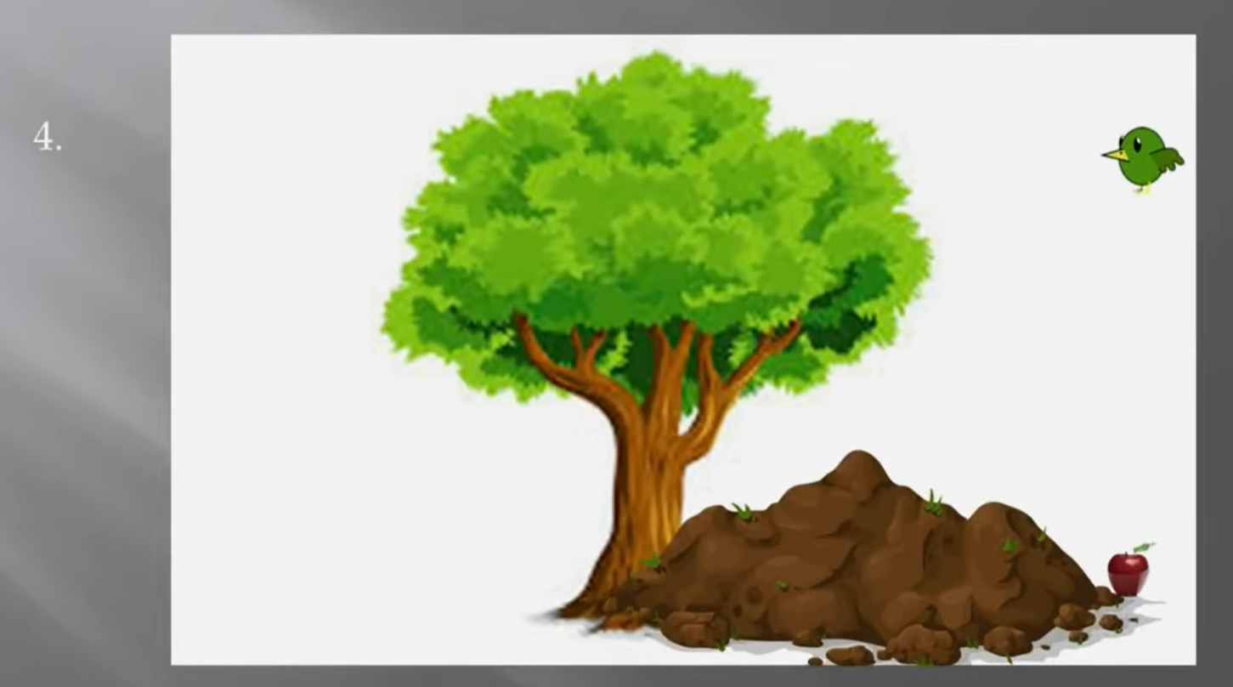

Slide 13
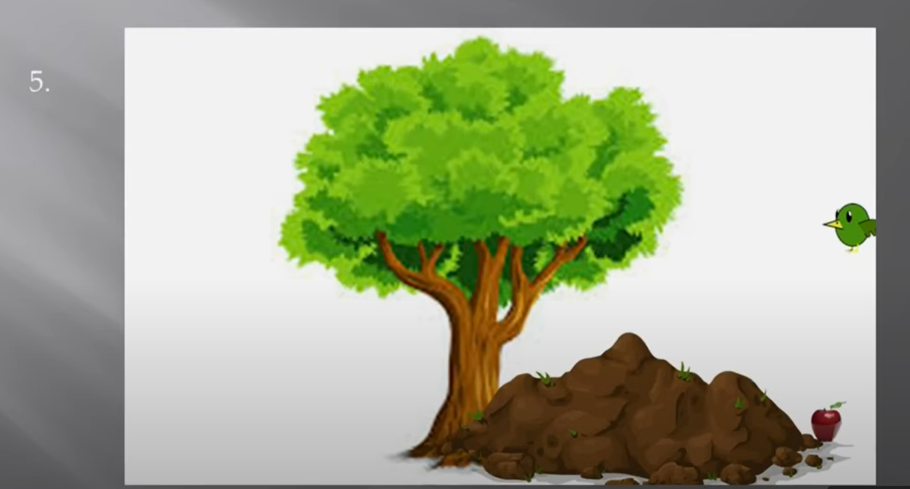

Slide 14
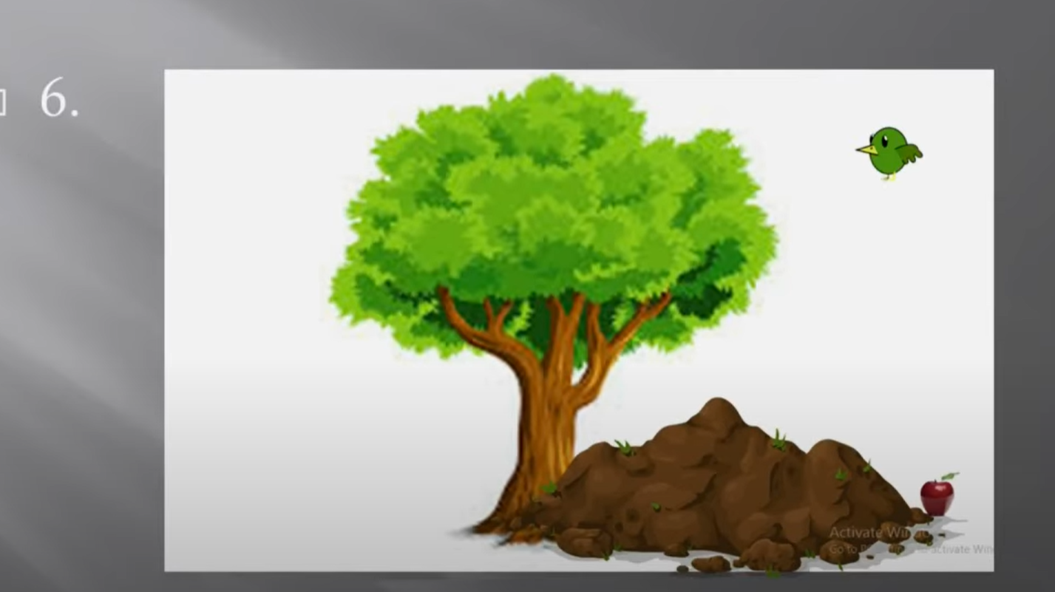

Slide 15
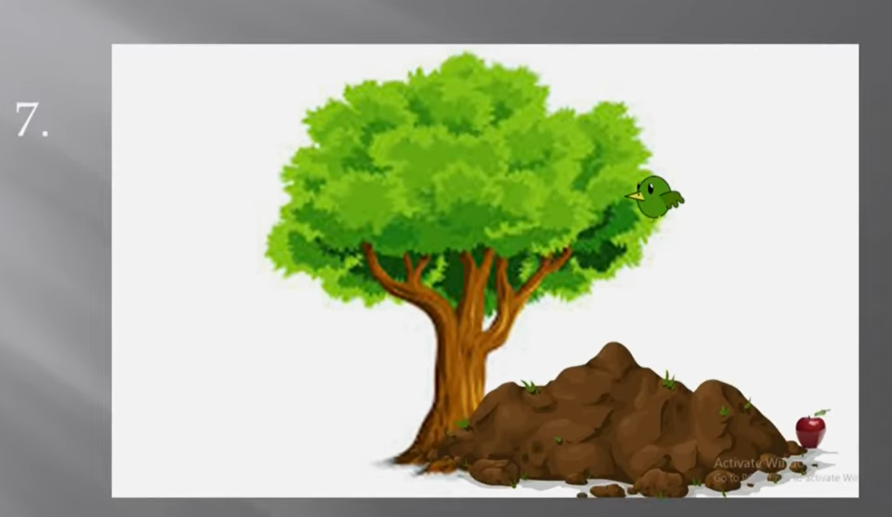

Slide 16
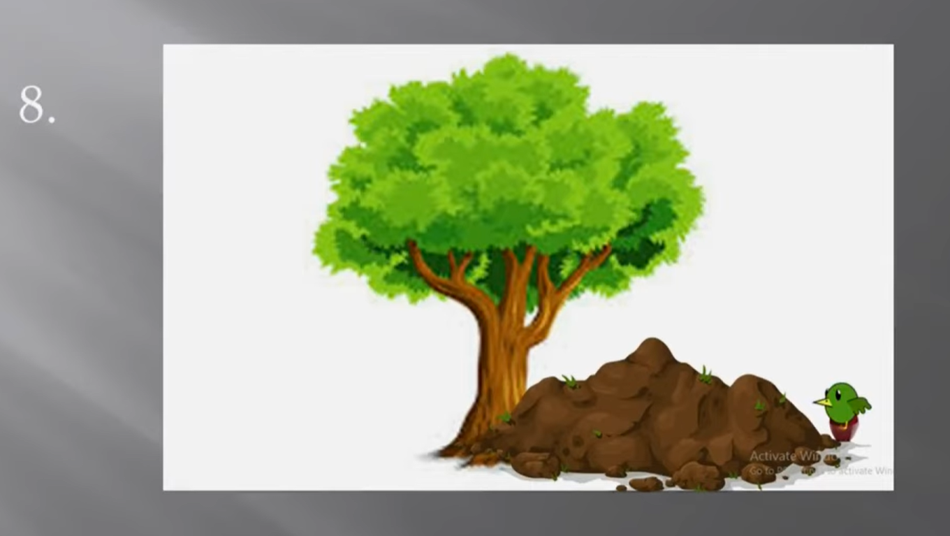

Slide 17
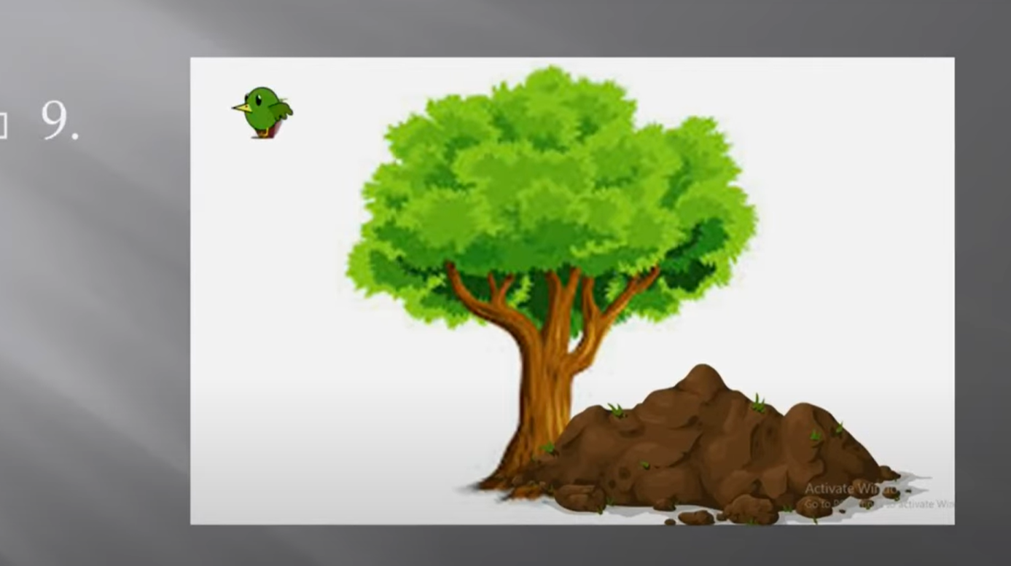

Slide 18


Slide 19
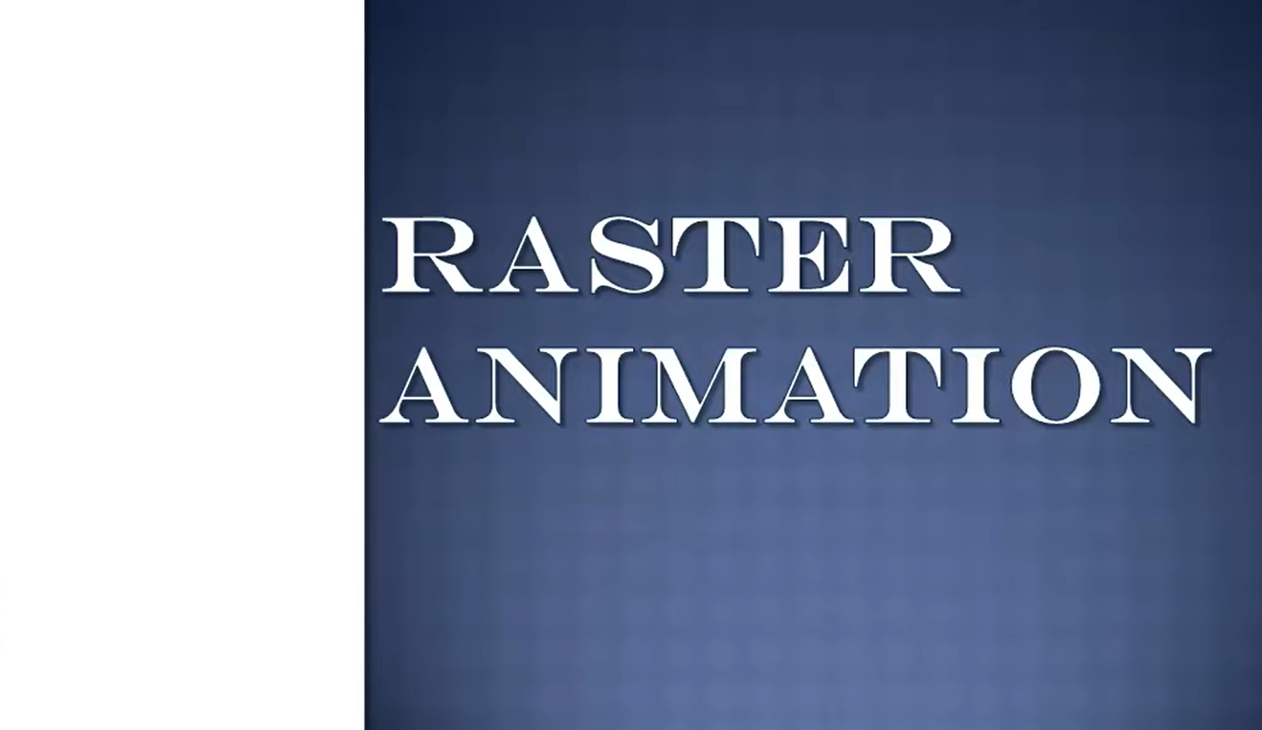

Slide 20
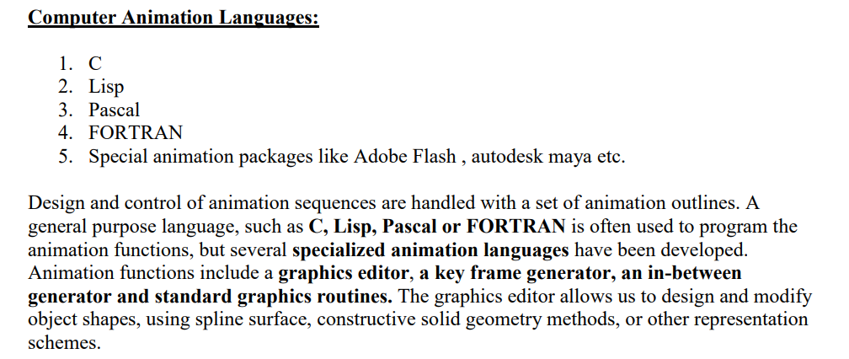

Slide 21
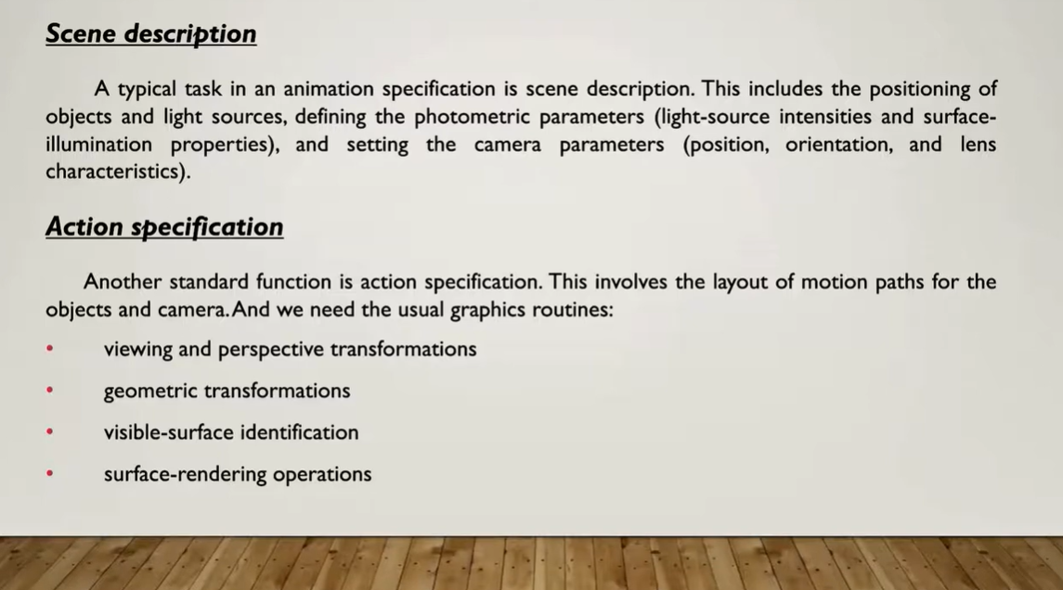

Slide 22
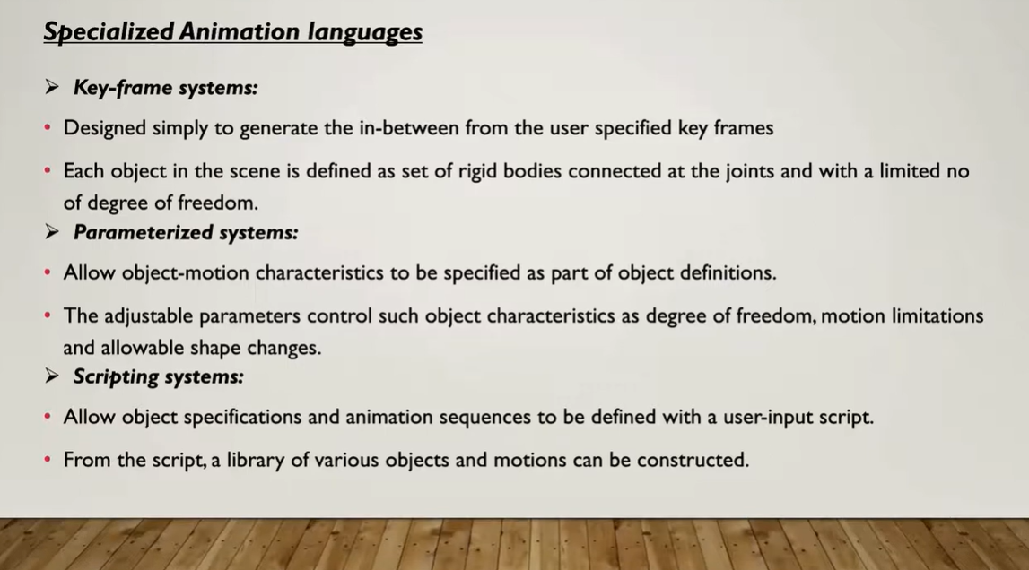

Slide 23
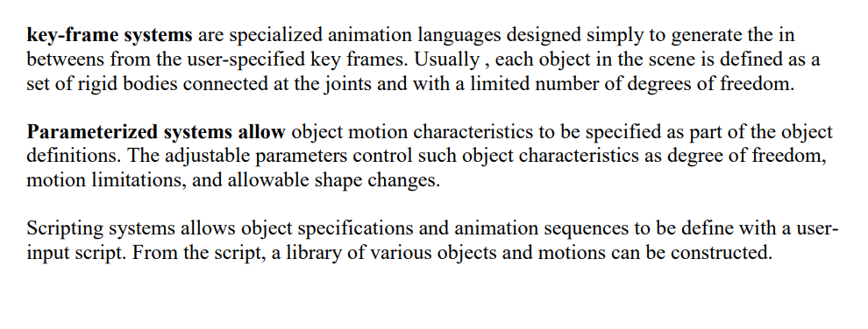

Slide 24
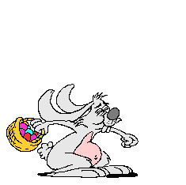
Motion Specifications
Various ways in which motions of objects ca be specified as:
Direct Motion Specification.
Goal-Directed Systems.
Kinematics and Dynamics.

Slide 25
Direct motion specification : -
The most straightforward method for defining a motion sequence is direct specification of the motion paremeters. Here, We explicitly give the rotation angles and translation vectors. Then the geometric transformation matrices are applied to transform co-ordinate positions. Alternatively, We could use an approximating equation to specify certain kinds of motions. These methods can be used for simple user programmed animation sequences.
Eg: Bouncing ball
Moving car changed into another object

Slide 26
Goal-directed systems : -
At the opposite extreme, We can specify the motions that are to take place in general terms that abstractly describe the actions. these systems are referred to as goal directed because they determine specific motion parameters given the goals of the animation. For example, We could specify that we want an object to "walk " or to "run" to a particular destination. Or We could state that we want an object to "pick up " some other specified object. The input directive are then interpreted in term of component motions that will accomplish the selected task. Human motion, for instance, can be defined as a heirarchical structure of sub motion for the toros, limbs,and so forth.

Slide 27
Kinematics and dynamics : -
We can also construct animation sequences using kinematic or dynemic descriptions. With a kinematic description, we specify the animation by giving motion parameters position, velocity, and acceleration) without reference to the forces that cause the motion. for constant velocity (zero acceleration), we designate the motions of rigid bodies in a scene by giving an initial position and velocity vector for each objects.

Slide 28
An alternate apporach is to use inverse kinematics. Here, we specify the initial and final positions of objects at specified times and the motion parameters are computed by the system . For example, assuming zero acceleration , we can determine the constant velocity that will accomplish the movement of an object from the initial position to the final position.

Slide 29
Dynamic descriptions on the other hand, require the specification of the forces that produce the velocities and acceleration. Descriptions of object behavior under the are generally referred to as a physically based modeling. Example of forces affecting object motion include electromagnetic, gravitational, friction, and other mechanical forces.

Slide 30
Keyframe System
A Key-frame in an animation is a drawing that defines the starting and ending points of any smooth transition. The drawings are called “frames” because their position in time is measured in frames on a strip of a film. A sequence of key frames defines which movement the viewer will see, whereas the position of the key frames on the film, video or animation defines the timing of the movement. Because only two or three key frames over the span of a second do not create the illusion of movement,the remaining frames are filled with in-betweens.

Slide 31
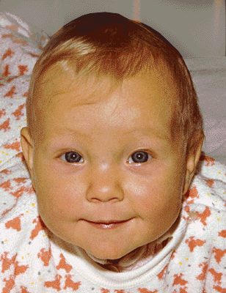
MORPHING

Slide 32
Morphing
Transformation of object shapes from one form to another is called morphing.
We generate set of in-betweens from the specification of two or more key frames. Given the animation paths we can interpolate the positions of individual objects between any two times or key frames. With complex object transformations the shapes of the object may change over time. If all surfaces are described with polygon meshes then the number of edges per polygon can change from one frame to the next. Thus the total number of line segments can be different in different frames.

Slide 33
Transformation of object shapes from one form to another is called morphing. Morphing methods can be applied to any motion or transition involving a change of shape.
Given two key frames for an object transformation we first adjust the object specification in one if the frames so that the number of polygon edges (or the number of vertices) is the same for the two frames. This is illustrated below

Slide 34
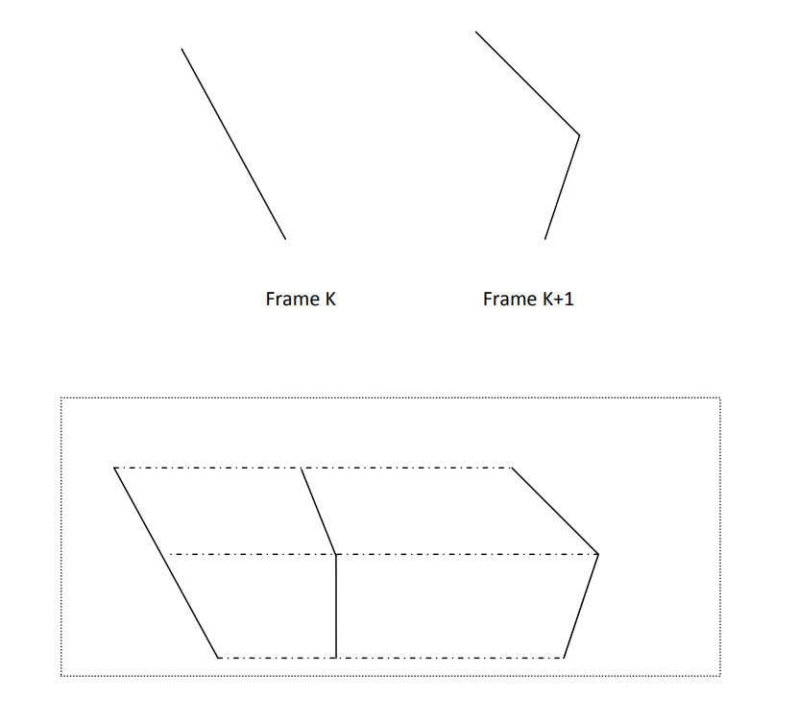

Slide 35
A straight-line segment in key frame k is transformed into two line segments in key frame k+1. Since key frame k+1 has an extra vertex, we add a vertex between 1 and 2 in key frame K to balance the number of vertices and edges in the two key frames.
Using linear interpolation to generate the in betweens we transition the added vertex in key frame k into vertex 3’ along the straight-line path as shown.We can state general preprocessing rules for equalizing key frames in terms of either the number of edges or the number of vertices to be added to a key frame.

Slide 36
Case 1: Equalizing edge count.
Let the parameters Lk and Lk+1 denote the number of line segments in two consecutive frames.
We then define
Lmax = max(Lk, Lk+1)
Lmin = min(Lk, Lk+1)
Ne = Lmax mod Lmin
Ns = int(Lmax/ Lmin)

Slide 37
Then the preprocessing is accomplished by
1. Dividing the Ne edges of keyframemin into Ns sections.
2. Dividing the remaining lines of keyframemin into Ns sections

Slide 38
Case 2: Equalizing vertex count
Let the parameters be Vk and Vk+1 denote the number of vertices in the two consecutive frames.
We define
Vmax = max(Vk, Vk+1)
Vmin = min(Vk, Vk+1)
Nls = (Vmax-1)mod (Vmin-1)
Np = int ((Vmax-1)/ (Vmin-1))
Preprocessing using vertex count is performed by
1. Adding Np points to Nls line sections of keyframemin
Adding Np-1 points to the remaining edges of keyframemin

Slide 39
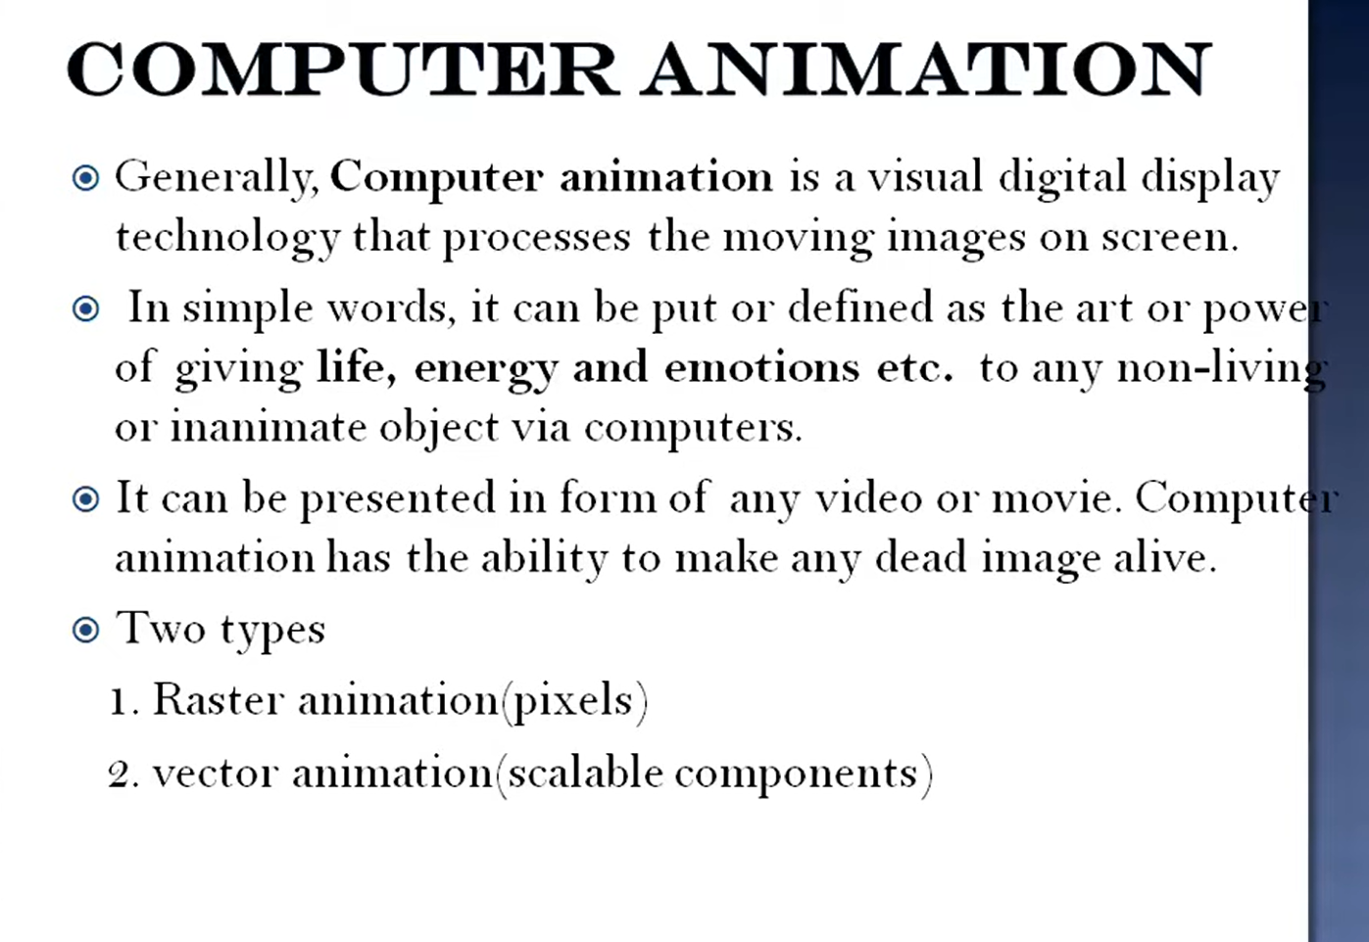

Slide 40
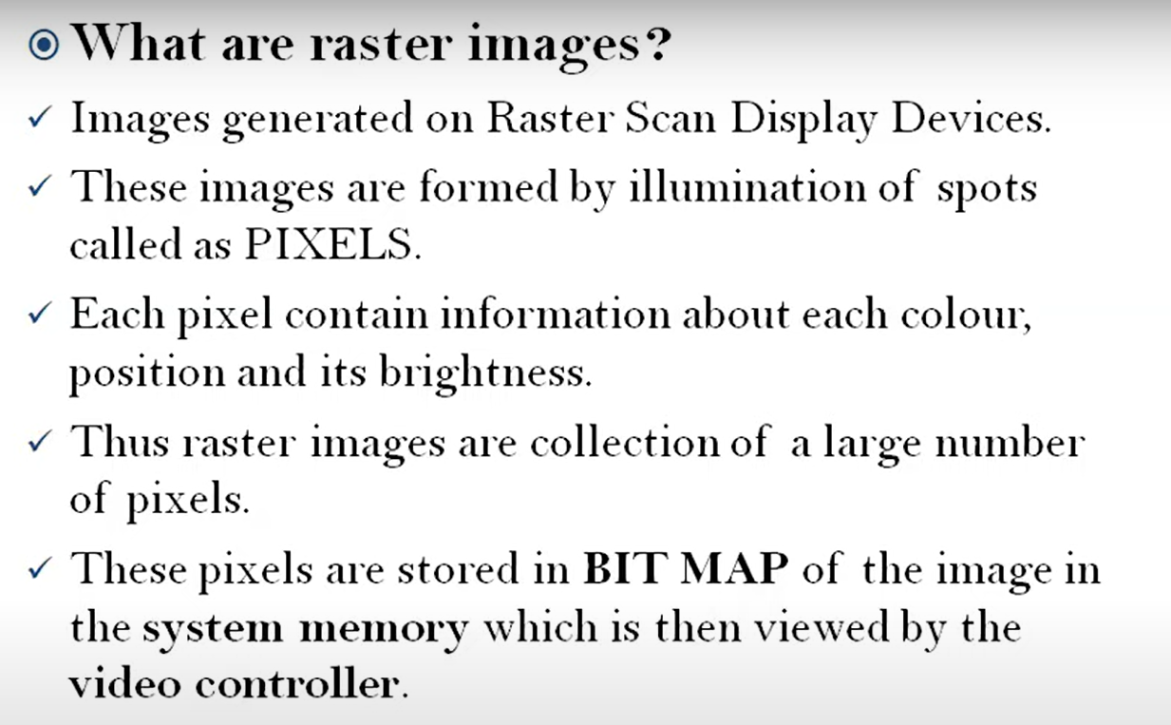

Slide 41
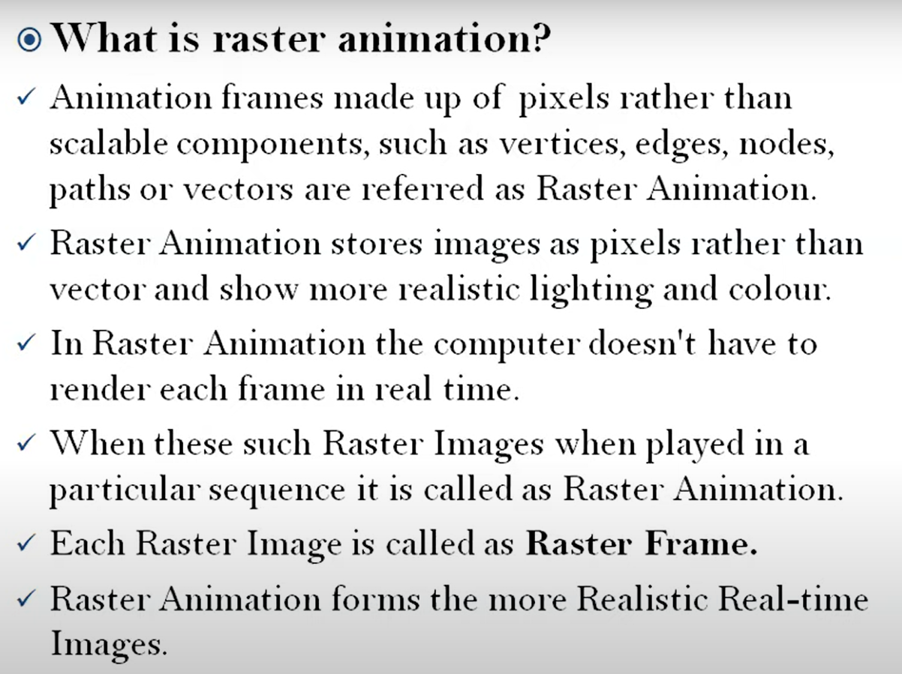

Slide 42
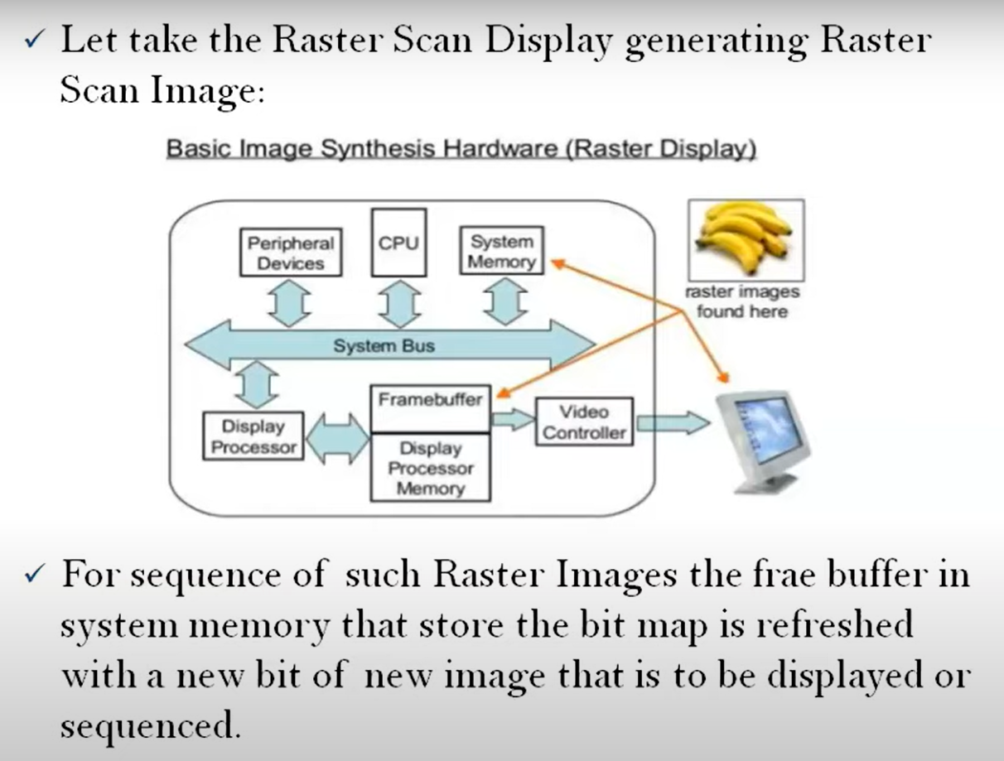

Slide 43
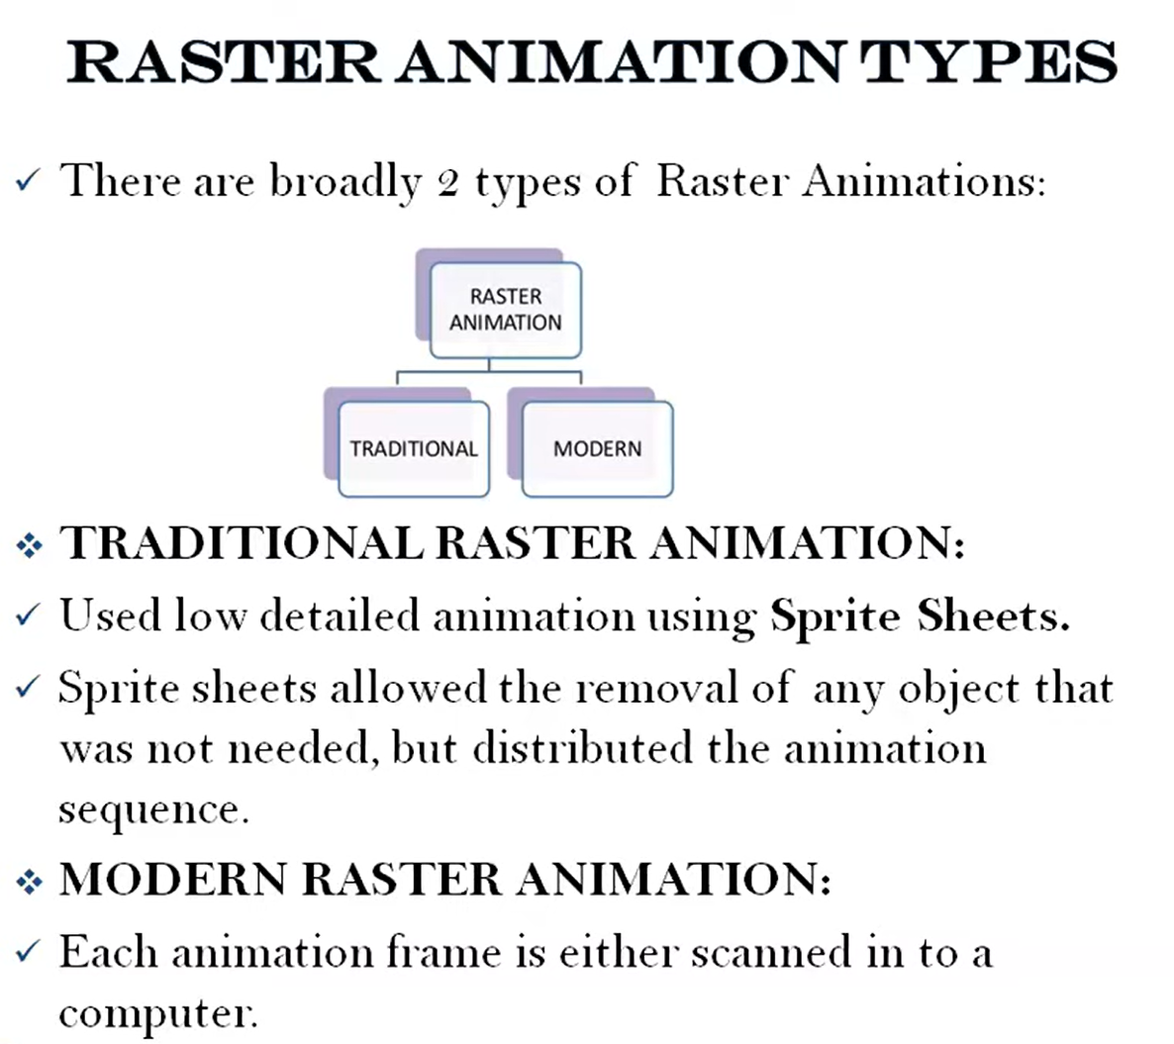

Slide 44
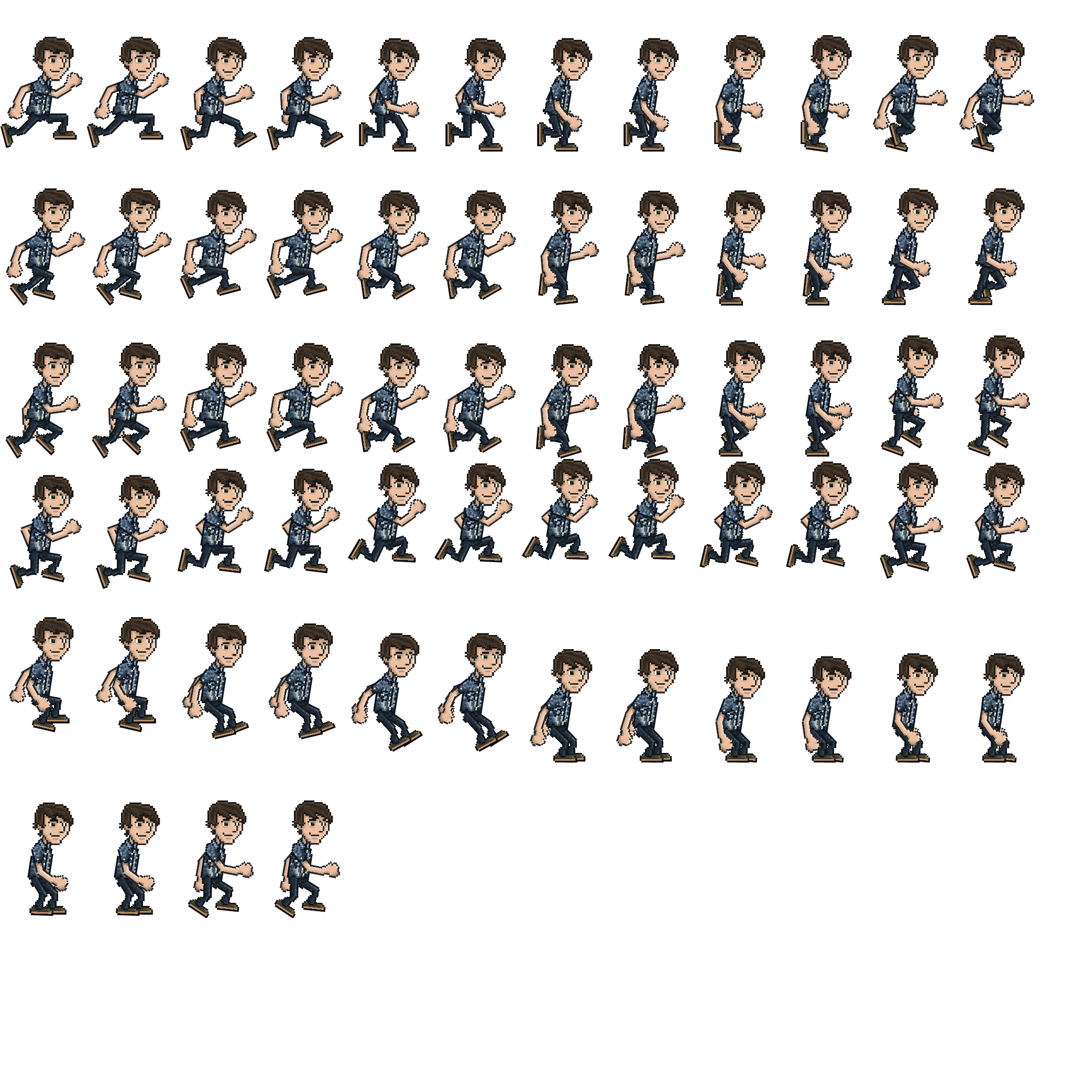
sprite sheet animation

Slide 45
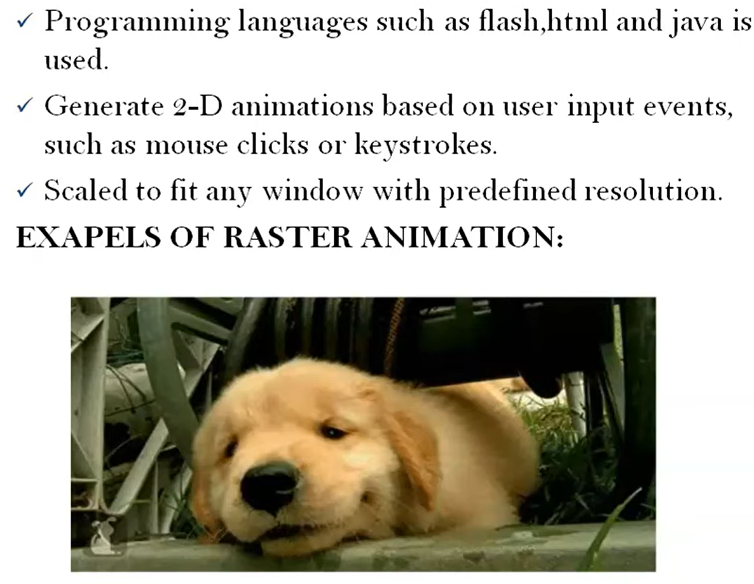

Slide 46
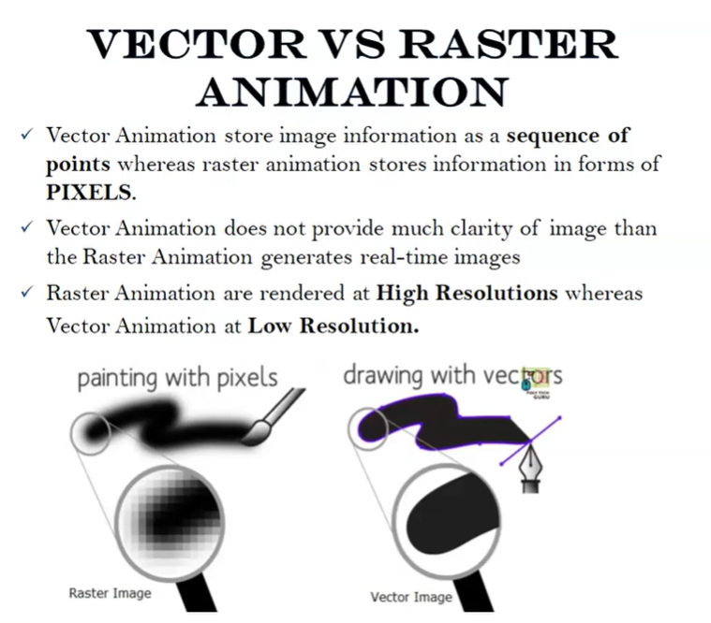

Slide 47
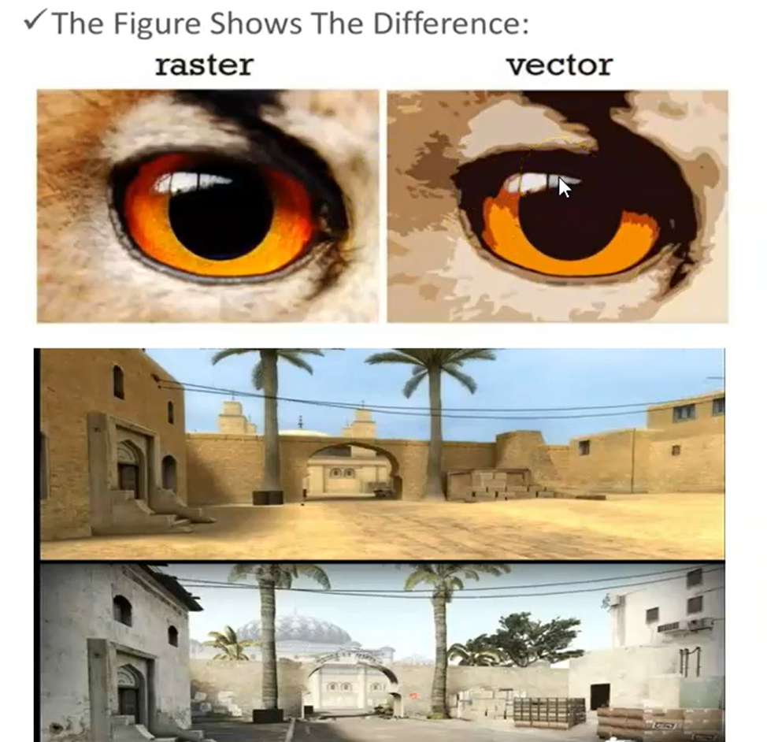

Slide 48
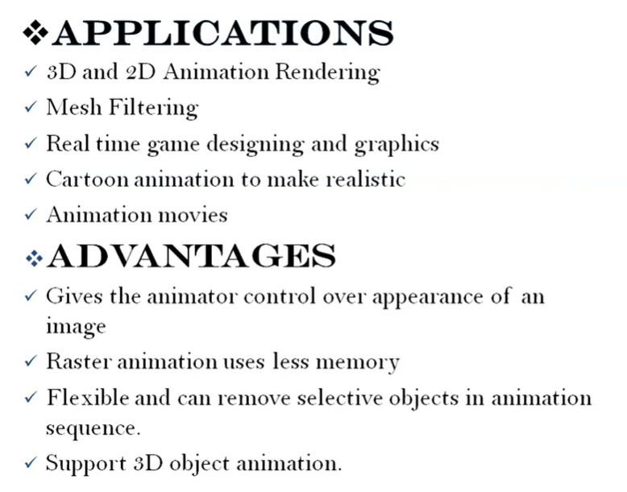

Slide 49
